Slide 1

고급AI융합프로젝트 – Final Report
Combining Video Class Solution with Face Recognition Solution
206480 이기성
Notes:
Hello
My topic is combining video class solustion with Face Recognition solution

Slide 2
Content
1. Subject
2. Problem
3. Solution
01. 인성 면접
4. Structure
02. 토론 면접
5. Implementation
6. Demonstration Video
7. Schedule
8. Reference

Slide 3
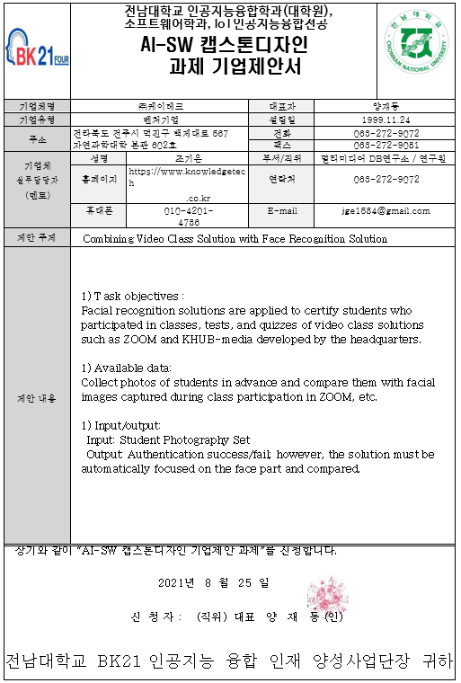
Subject
Combining Video Class Solution with
Face Recognition Solution
- ㈜케이테크

Slide 4
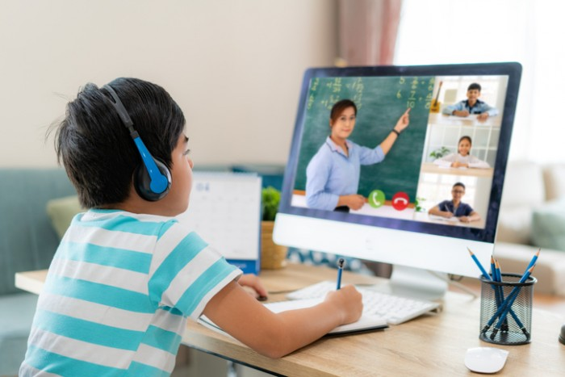
Subject
The importance of remote classes is being emphasized due to COVID-19.

Slide 5
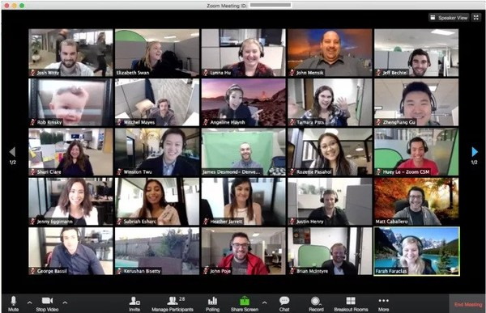
Problem
From an educator's point of view, the more the number of people increases,
the more difficult it is to conduct classes remotely than on-site attendance checks.

Slide 6
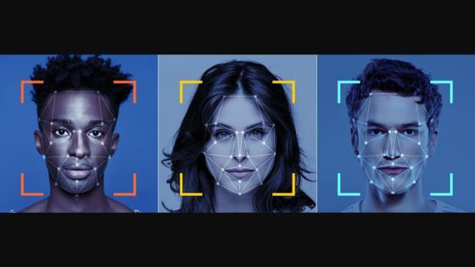
Solution
If you automatically check attendance using face recognition, The burden of remote classes can be reduced.

Slide 7

Structure

Slide 8
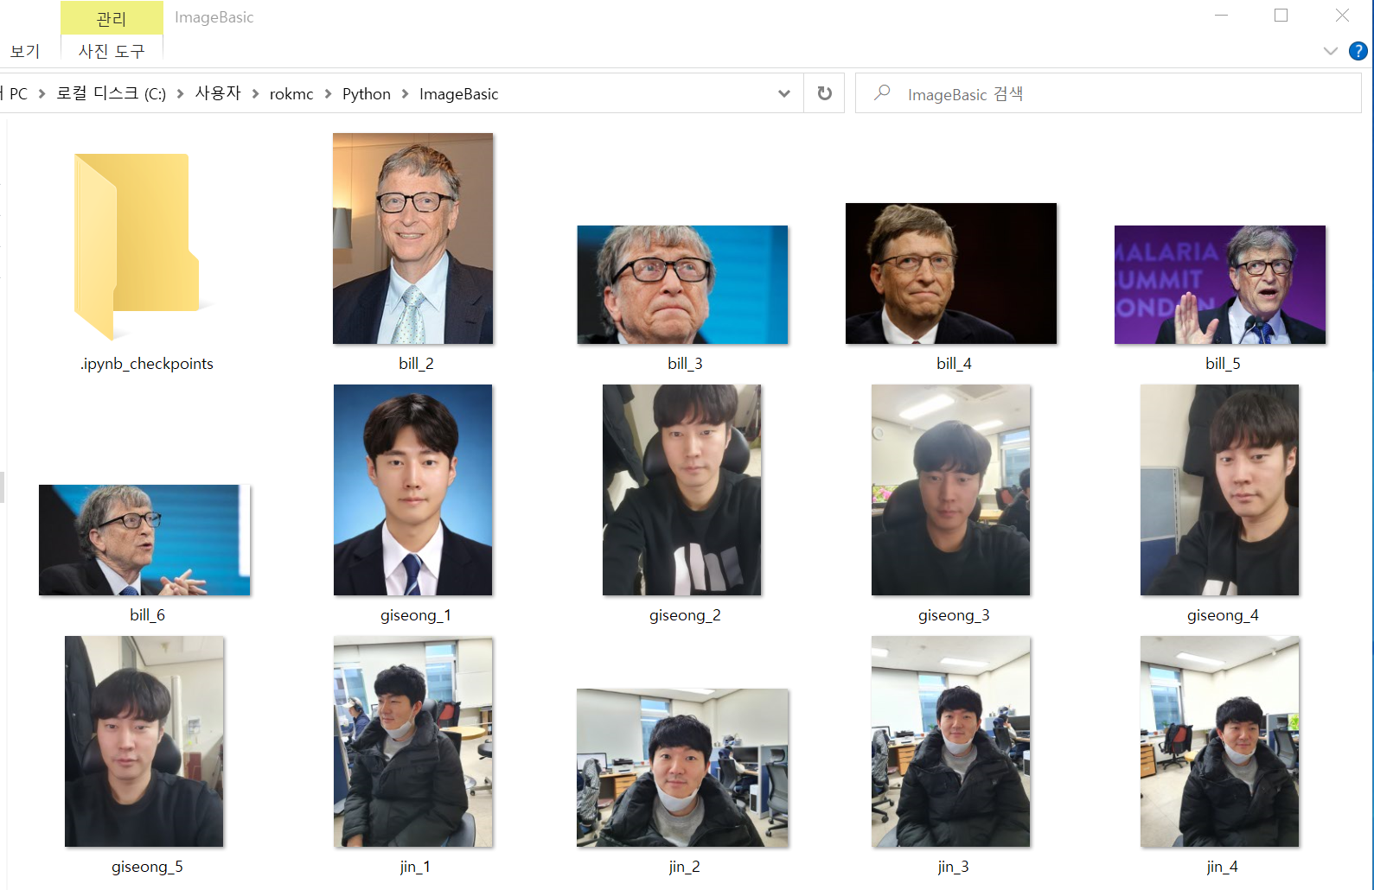
Structure

Slide 9
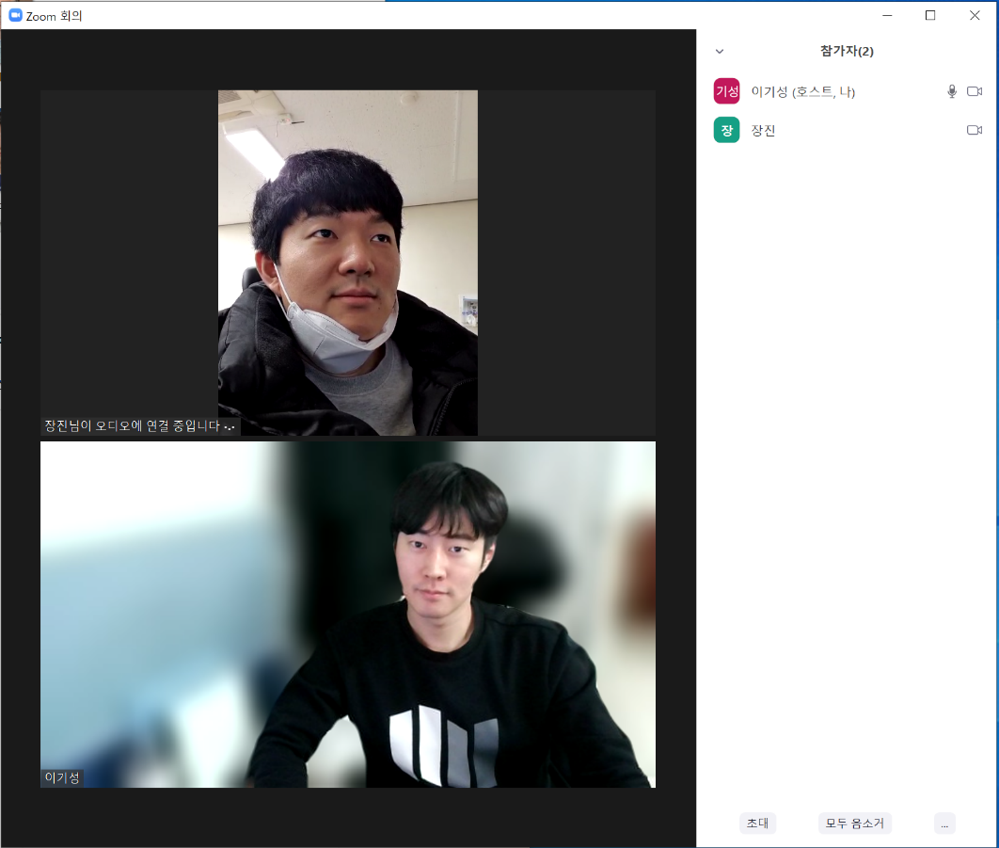
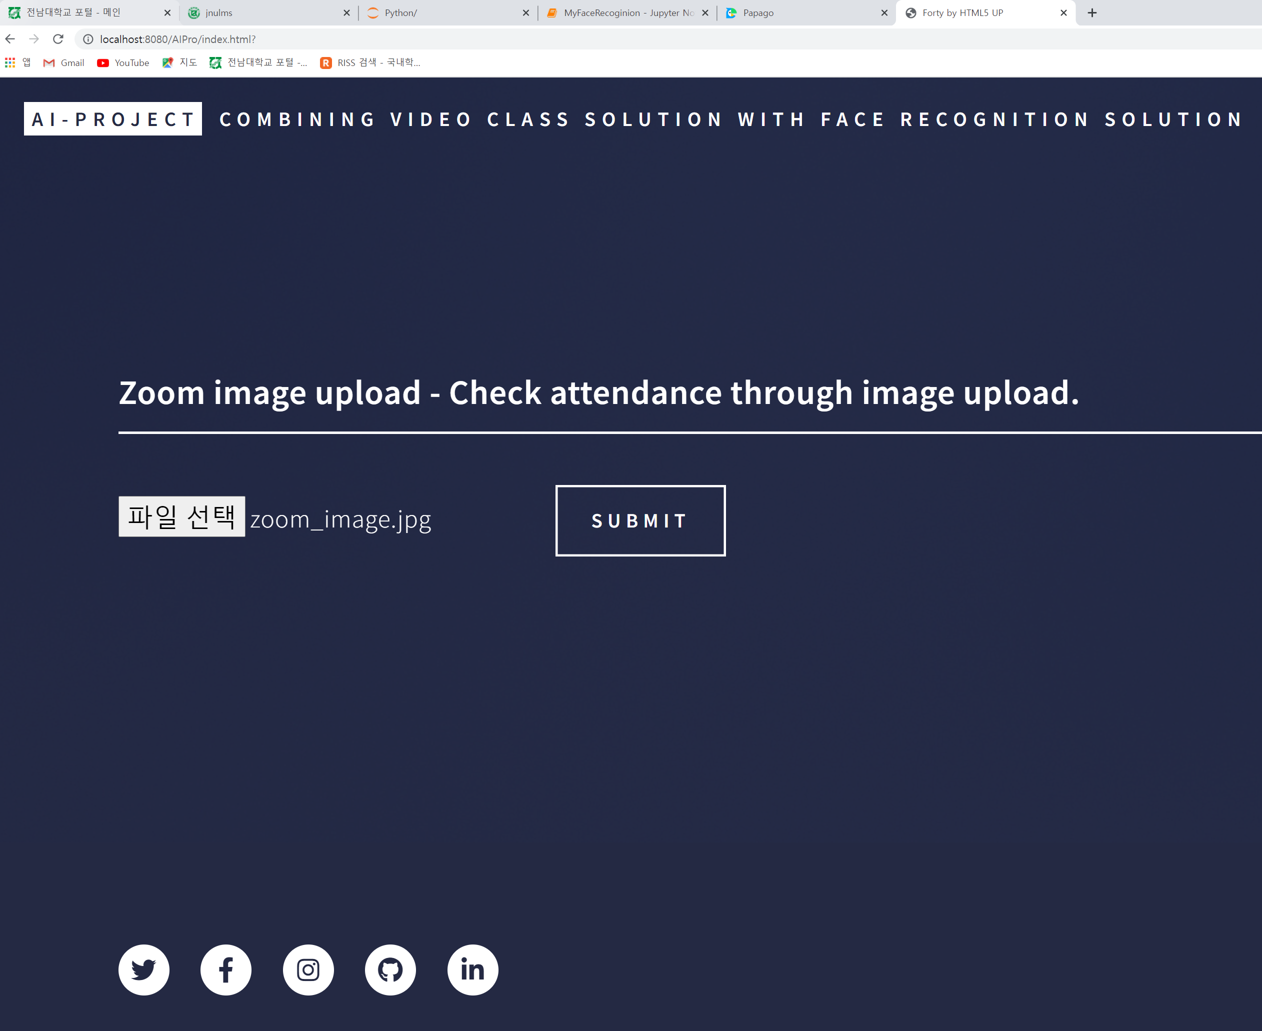
Structure

Slide 10

Structure

Slide 11
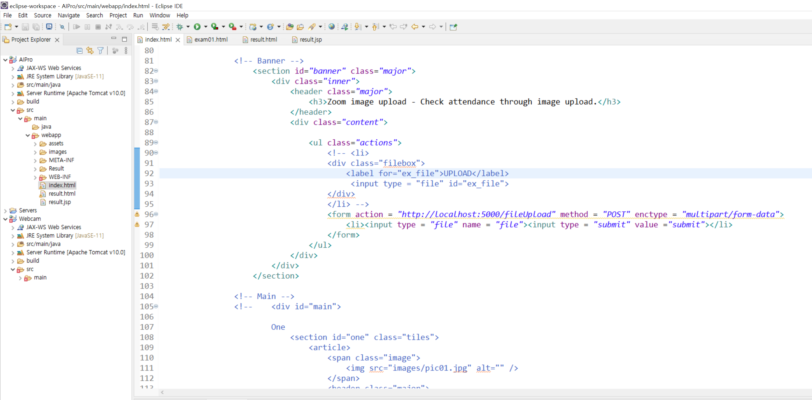
implementation.
Use Eclipse to implement the web.

Slide 12
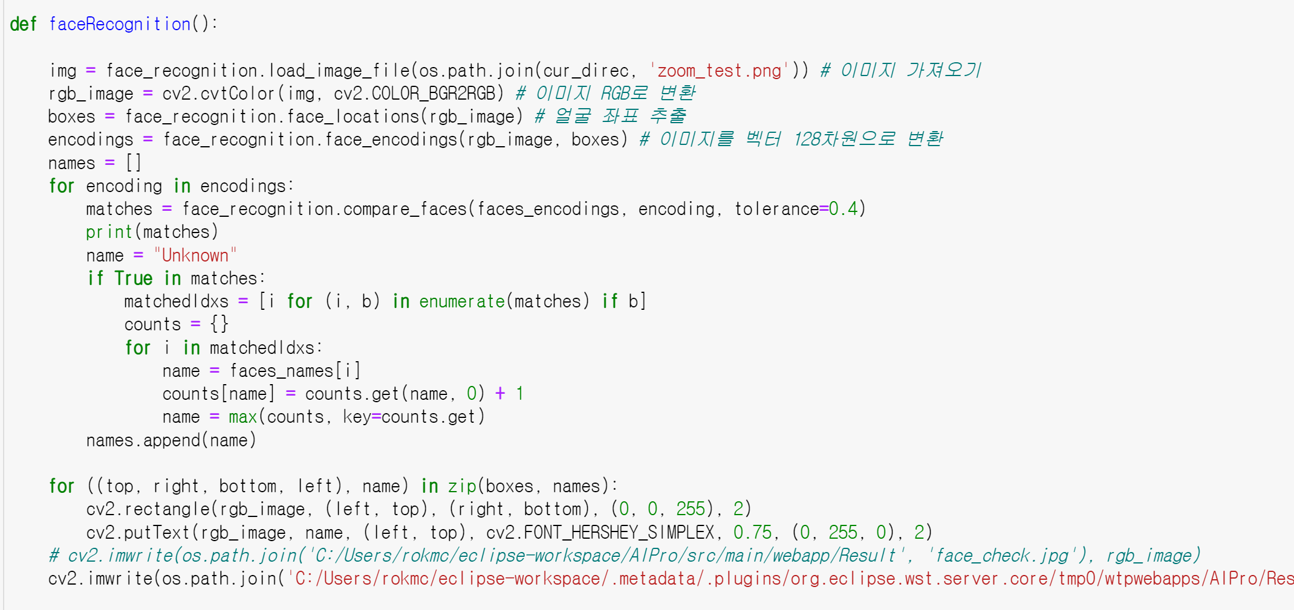
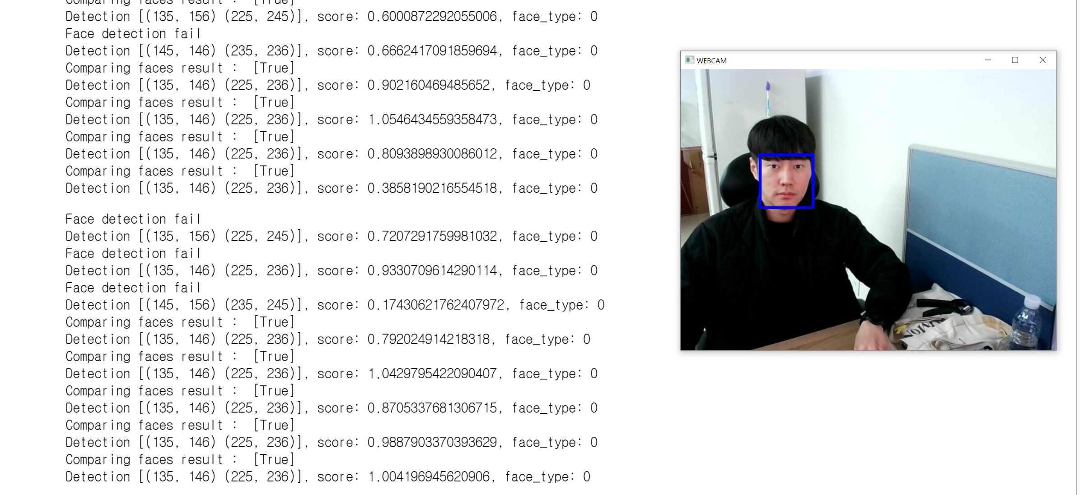
implementation.
Using Python face_recreation to recognize your face.

Slide 13
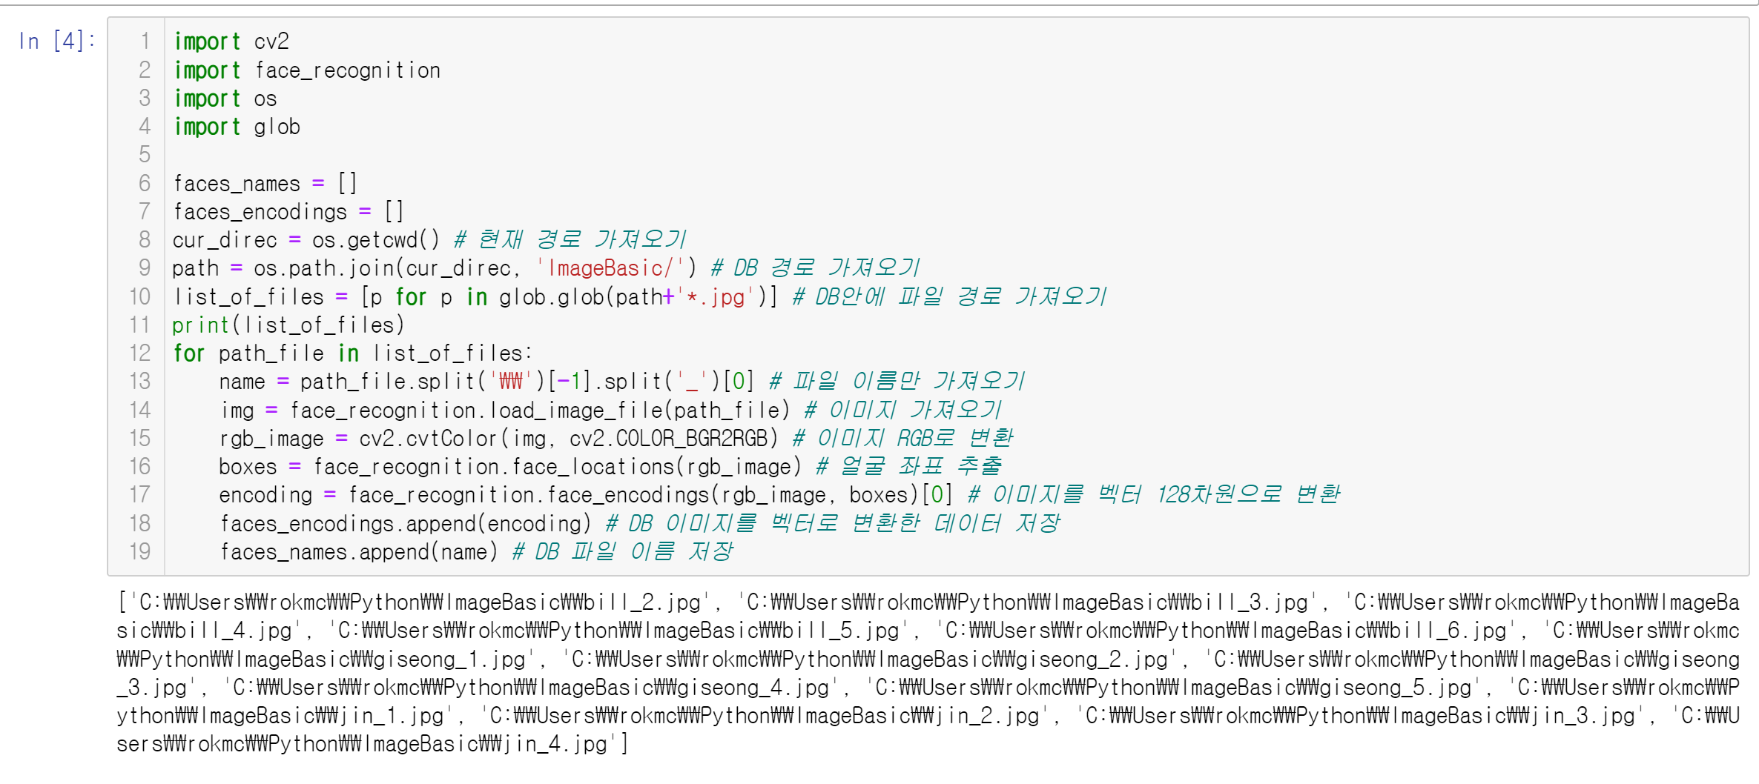
implementation.
Learning from Python to prove your face.

Slide 14
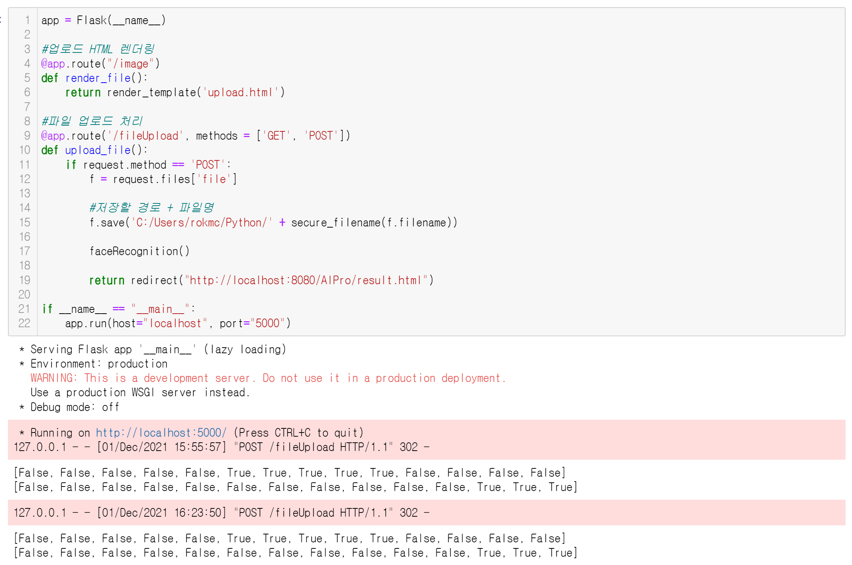
implementation.
Use a flask for communication between the web and Python.

Slide 15
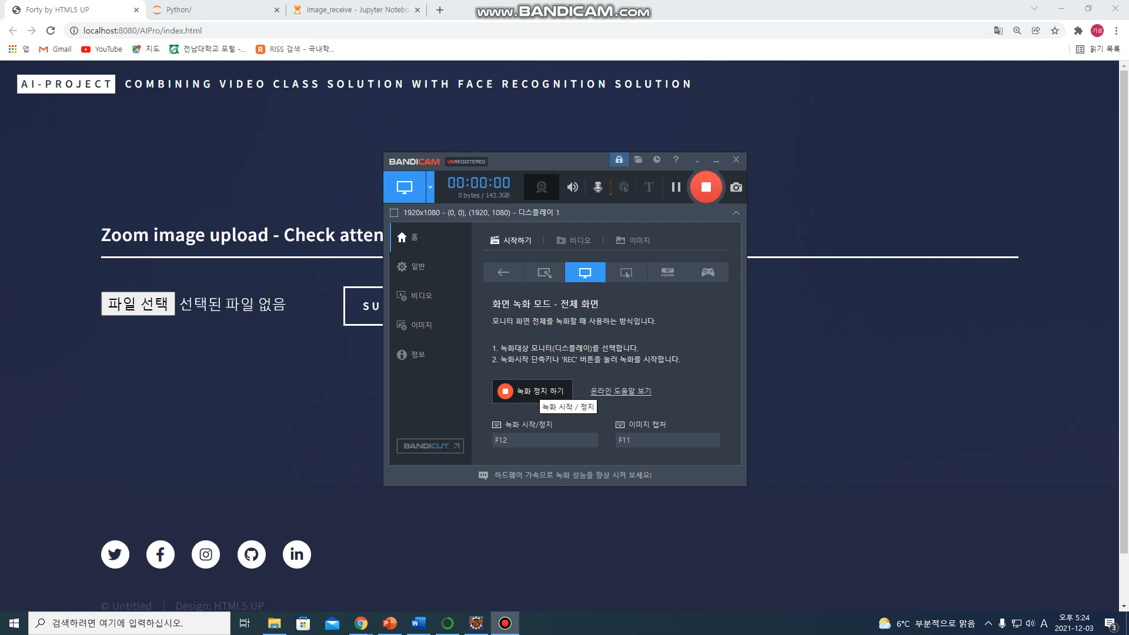
Demonstration video.

Slide 16
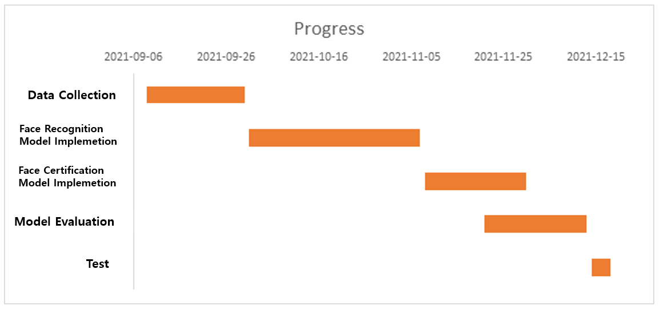
Schedule

Slide 17
3. Reference
3-1. Site
- https://hayunjong83.tistory.com/38
- https://m.blog.naver.com/PostView.naver?isHttpsRedirect=true&blogId=shshrka001&logNo=20198208984
- https://bluelimn.tistory.com/572
- https://needjarvis.tistory.com/641
http://www.gisdeveloper.co.kr/?p=6317
https://deep-eye.tistory.com/18
https://minimin2.tistory.com/139
https://m.blog.naver.com/chandong83/221436424539
https://isss.tistory.com/295
https://stickode.tistory.com/197
https://wiserloner.tistory.com/1123
https://ponyozzang.tistory.com/597
https://thecodingnote.tistory.com/8
https://bonggang.tistory.com/324
https://ryanclaire.blogspot.com/2020/11/face-detection-example-using-Python-OpenCV.html
Notes:
This is the reference I referred to for work.

Slide 18
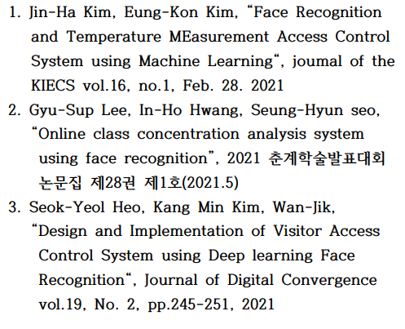
3. Reference
3-2. Papers
Notes:
This is the reference I referred to for work.

Slide 19
Thanks you

